Slide 1
Practical
Electronics
& Programming
with Arduino
Session 3: Strings Cont.

Slide 2
What is an array?
Arrays are data stored back-to-back:
byte nums[] = { 1, 2 }
1
2
0000 0001 0000 0010

Slide 3
Arrays
You can access individual parts based on an 'index' that starts at 0:
1
2
nums =
0000 0001 0000 0010
1
2
nums[0] =
nums[1] =
0000 0001
0000 0010
index 0
index 1

Slide 4
What is a String?
Strings are arrays of characters (8 bits) terminated by a special '\0' character
"Hello."
=
H
e
l
l
o
.
\0

Slide 5
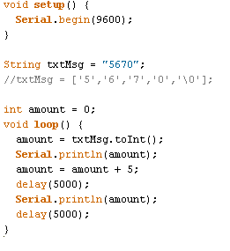
Number String Parsing
Takes input of 5670
Converts it to an int
Prints it
Add 5 to the converted input
Print it

Slide 6
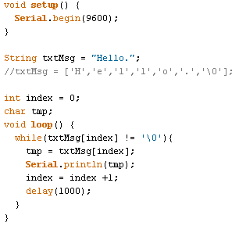
String Parsing
Until the string end is reached
Output:
H
e
l
l
o
.
Get the char at the index
Print it out
Advance one Character

Slide 7
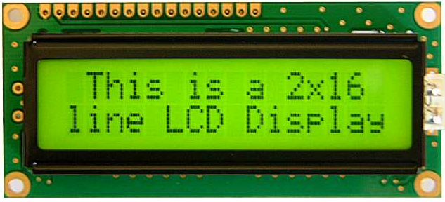
Character Display
http://arduino.cc/en/Tutorial/LiquidCrystal

Slide 8
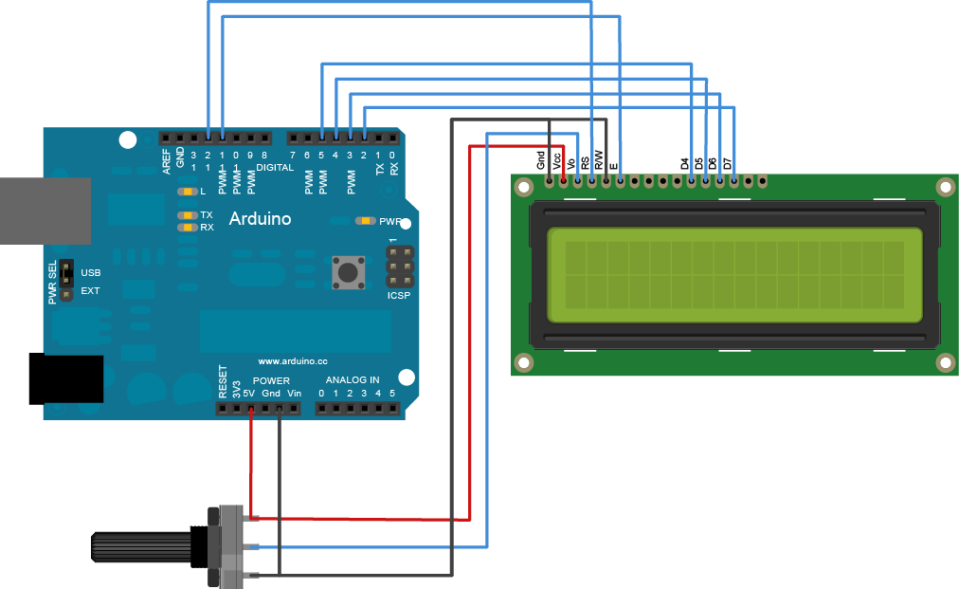
Example Wiring

Slide 9
Example Code
#include <LiquidCrystal.h>
// initialize the library with the numbers of the interface pins
LiquidCrystal lcd(12, 11, 5, 4, 3, 2);
void setup() {
// set up the LCD's number of columns and rows:
lcd.begin(16, 2);
// Print a message to the LCD.
lcd.print("hello, world!");
}
void loop() {
// set the cursor to column 0, line 1
// (note: line 1 is the second row, since counting begins with 0):
lcd.setCursor(0, 1);
// print the number of seconds since reset:
lcd.print(millis()/1000);
}

Slide 10
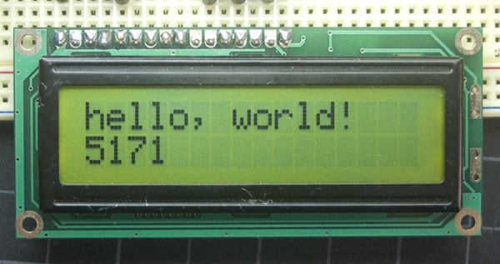
Character Display

Slide 11
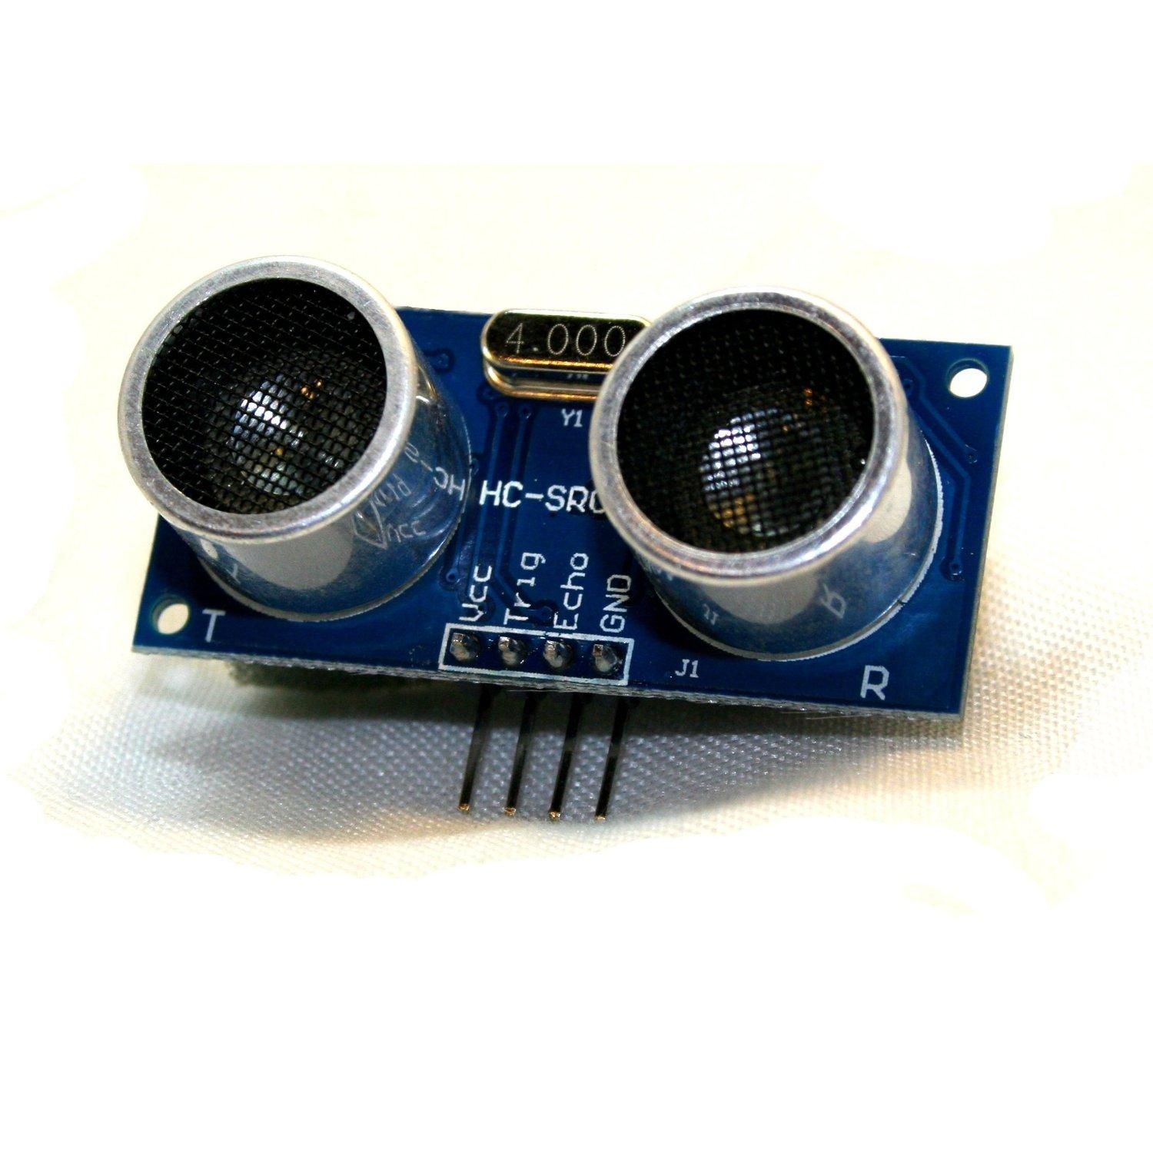
Ultrasonic Distance
Emitter
Receiver

Slide 12
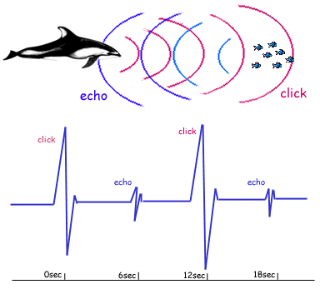
Ultrasonic Distance
1 - Ultrasonic Pulse sent
2 - Sounds bounces off target
3 - Bounced sound returns, time taken tells distance

Slide 13
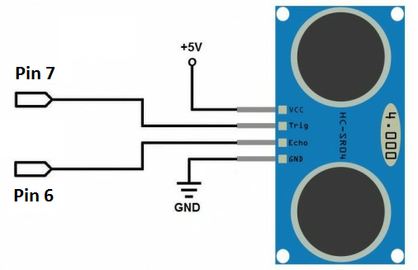
Interfacing

Slide 14
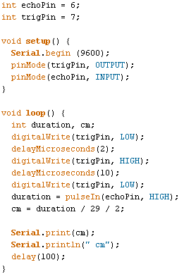
Example Code

